Slide 1


Sustainable Lighting Design - LED

Slide 2
We will review the following components of LED lighting design.
Products
Application
Controls
Advantages of LED

Slide 3
LED Lighting:
  Down lighting
  Linear Recessed
  Under Cabinet
  Site
Accent
Specialty

Slide 4
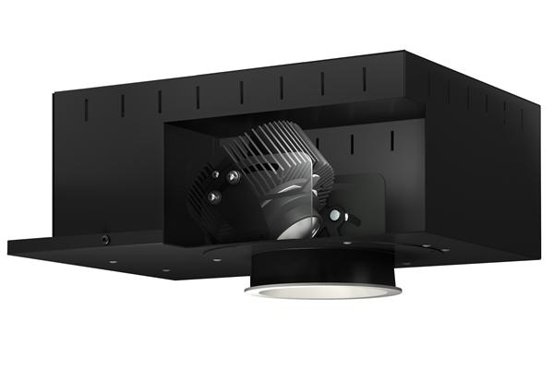
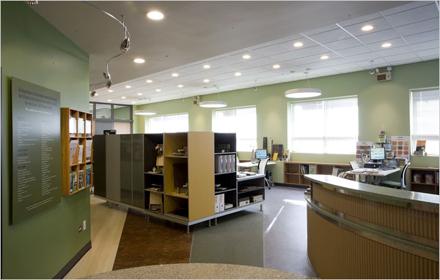
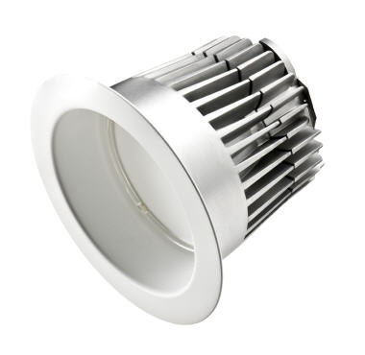
Down lighting

Slide 5
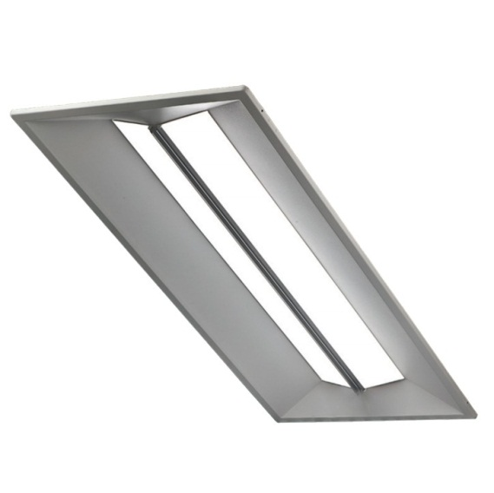
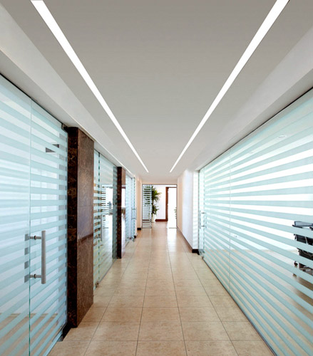
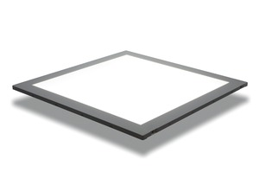
Linear Recessed

Slide 6
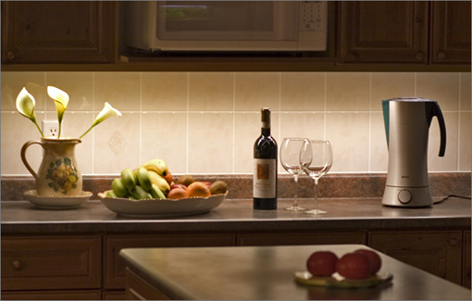
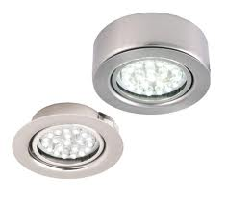
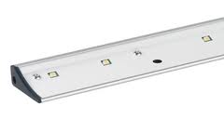
Undercabinet

Slide 7
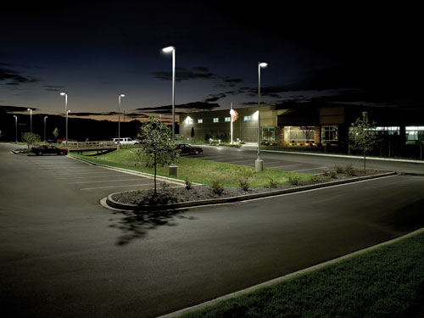
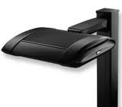
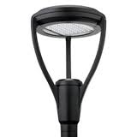
Site

Slide 8
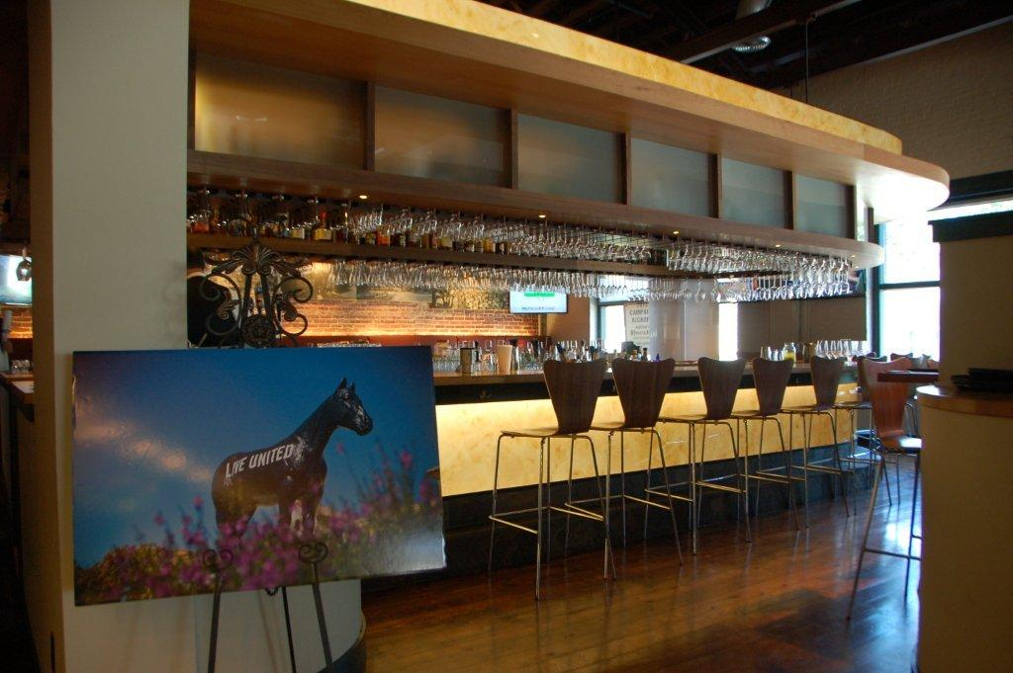
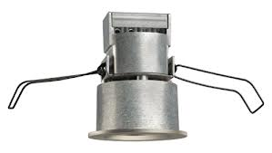
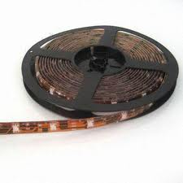
Accent

Slide 9
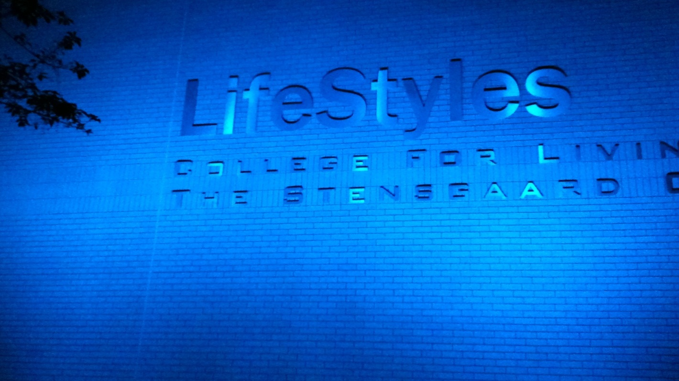
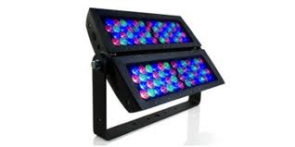
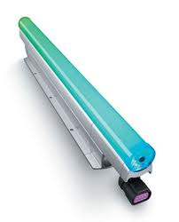
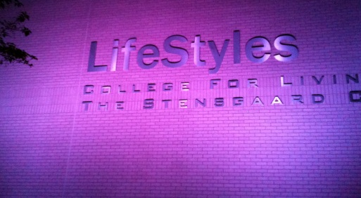
Specialty

Slide 10
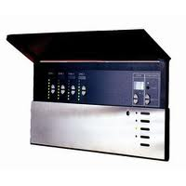
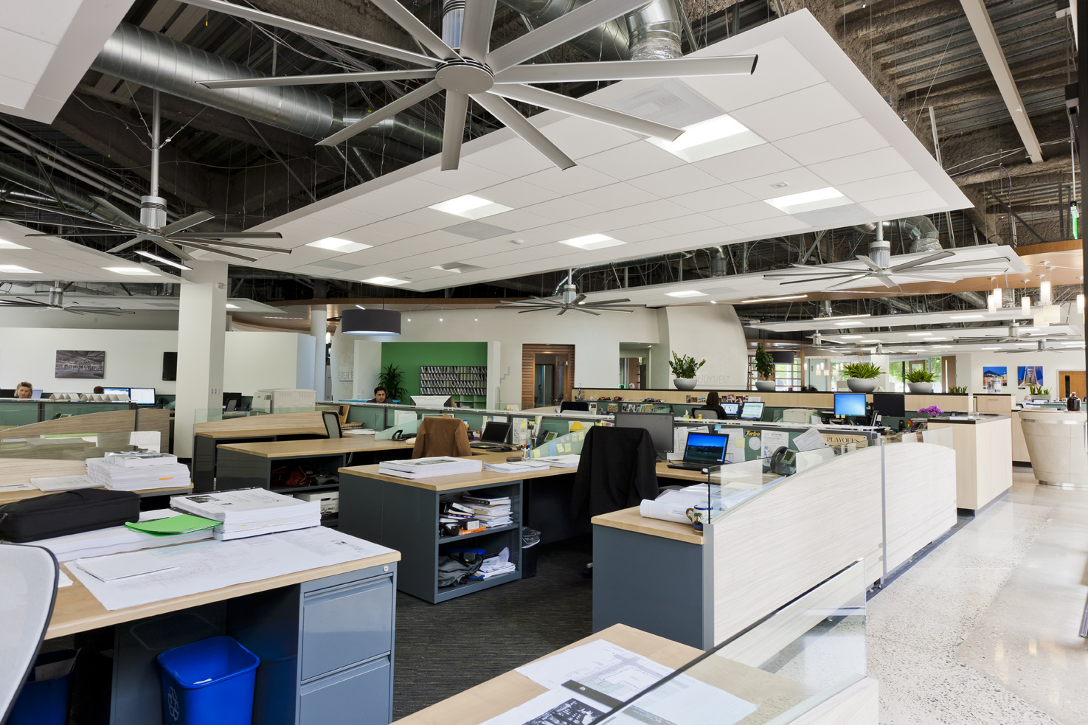
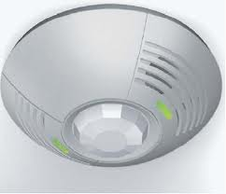
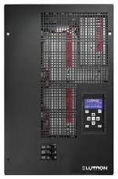
Controls
Room Control
Sensor Control
Panel Control

Slide 11
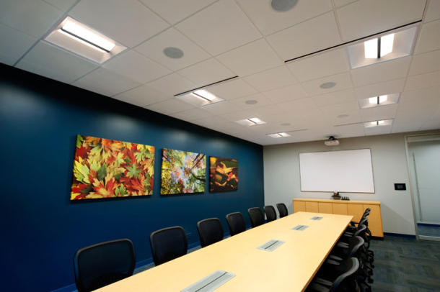
Advantages
0 – 10V dimming
Nano optics
DC input voltage
Small size
Eco friendly
Durable quality
Zero UV submissions
Cold temperature

Slide 12



LEED Check List Points
SSc8 Light Pollution Reduction - nano optics, LEED Optics
EAc1 Optimize Energy Performance – up to 19 total points
IEQc6.1Controllability of Systems - several options

