Slide 1
Dillard’s
Energy Management
Jeff Bowen
Dillard’s Stores Services, Inc.
Little Rock, AR

Slide 2
EMS
What it is –
  ASI Controls – Direct Digital Controls
  Web enabled
What we use it for –
  On/Off , Control temperature, control schedules, On/Off, troubleshooting
How many do we have –

Slide 3
What the System Does
Manages, monitors and controls energy usage
We configure and monitor our networked facilities through our web browser
We receive alarms and event notifications on email, mobile phone, or via text message
We update lighting and/or climate control schedules at a facility, set of facilities, or the entire network, with one command
We can integrate different devices from different manufacturers using ASI’s WebLink
We analyze and graph trend data online or export it to Excel for additional processing

Slide 4
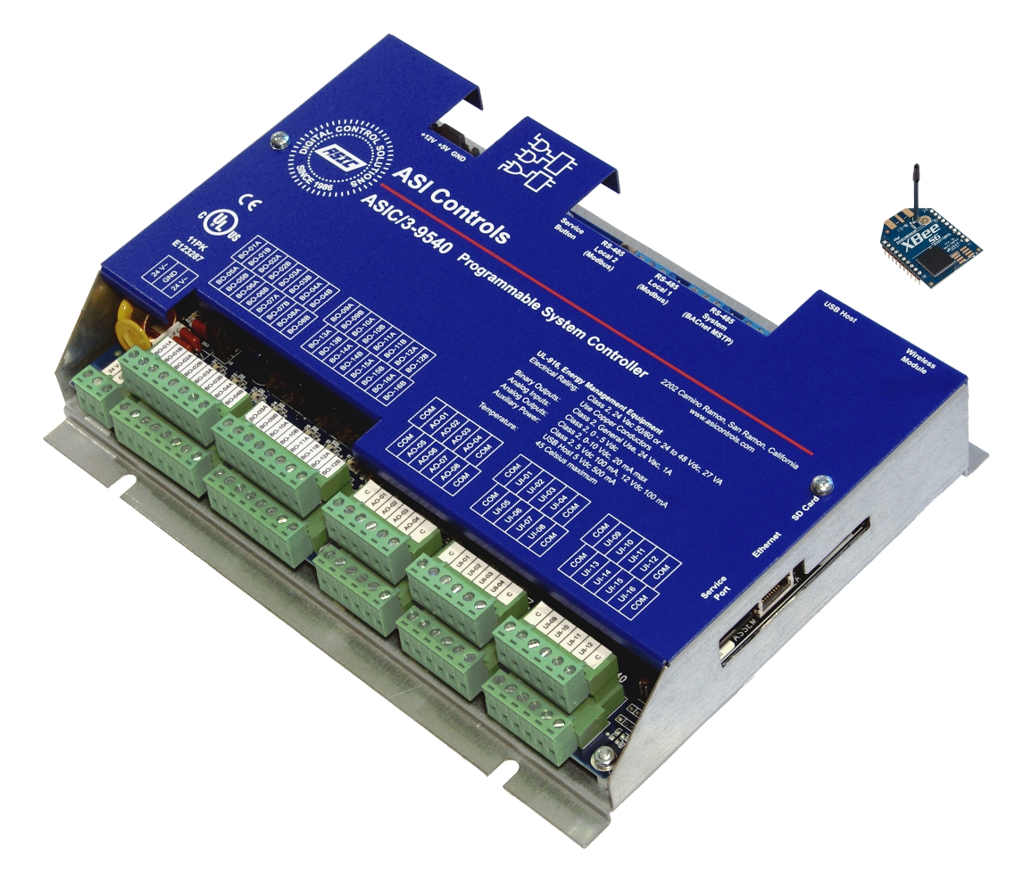
ASI Controller

Slide 5
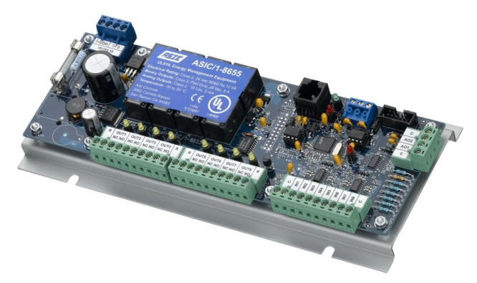
ASI Rooftop Unit Controller

Slide 6
How Many do we Have?
342 Stores (buildings) monitored
  292 are on a Wide Area Network (WAN)
  50 are on older dial-up technology
6 Distribution Centers monitored (WAN)
2 Data Centers monitored (WAN)
1 Corporate Office (WAN)
351 Total Systems Monitored

Slide 7
Roof Top Systems Monitoring
Roof Top HVAC Units –
  Space Temperatures (alarm for high and low)
  Unit Amperage
  Supply Air Temperature
  Return Air Temperature
  Monitor the difference between supply air temperature and return air temperature (alarm for high differences)
  Approximately 15 points monitored on each RTU
  225 – 400 points monitored per store for HVAC alone
  78,125 points monitored daily (using averages)

Slide 8
Chiller Systems Monitoring
Chiller Systems –
  Supply Air Temperature/Space Temperature (air handler)
  Amperage (chiller and air handlers)
  Chiller Alarms
  Chilled Water Temperatures
  Condenser Water Temperatures
  Cooling Tower Fan Status
  Approximately 1,875 points monitored daily on chillers

Slide 9
Lighting Controls
Lighting Controls are time based
  Separated into 4 quadrants per store, per floor
  Separated into –
    Work Lights – on 3 hours prior to store opening
    Sales Lights – on 15 minutes prior to store opening
    Feature Lights – on 8 minutes prior to store opening
Manual Overrides upon request
  Executive visits
  Store Maintenance
  Comfort Issues
  Temporary Schedule Changes (sales, etc.)

Slide 10
Main Control Panel
What else we monitor –
  Emergency Generator Status and Alarm Condition
  Escalator Run Status
  Lighting Panel Overrides
  Main Panel Override
  Building Power – Voltage, kW, kWh, power factor
  Photocells
  Outside Air Temperature
  Interior Humidity
  Building Security System
  Monitors Communication to HVAC systems

Slide 11
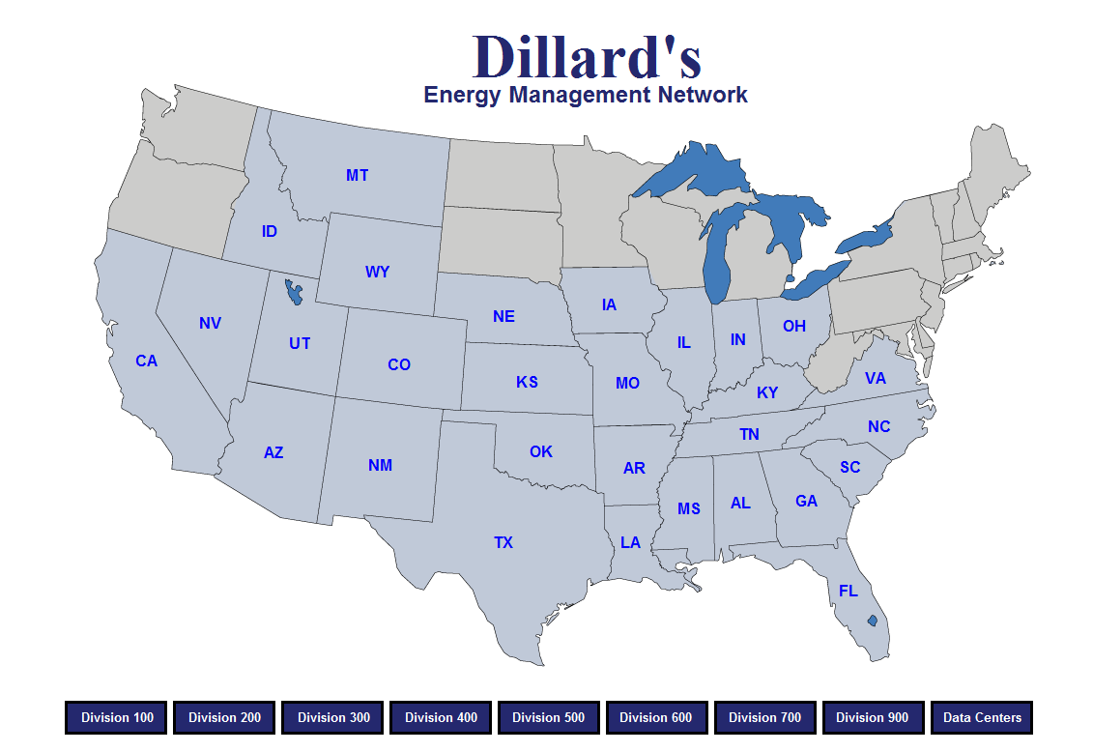

Slide 12
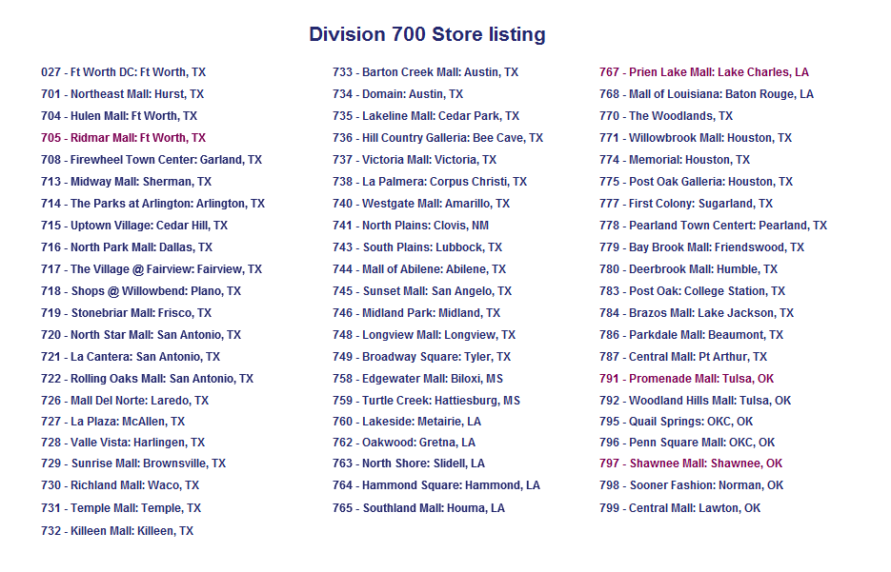

Slide 13
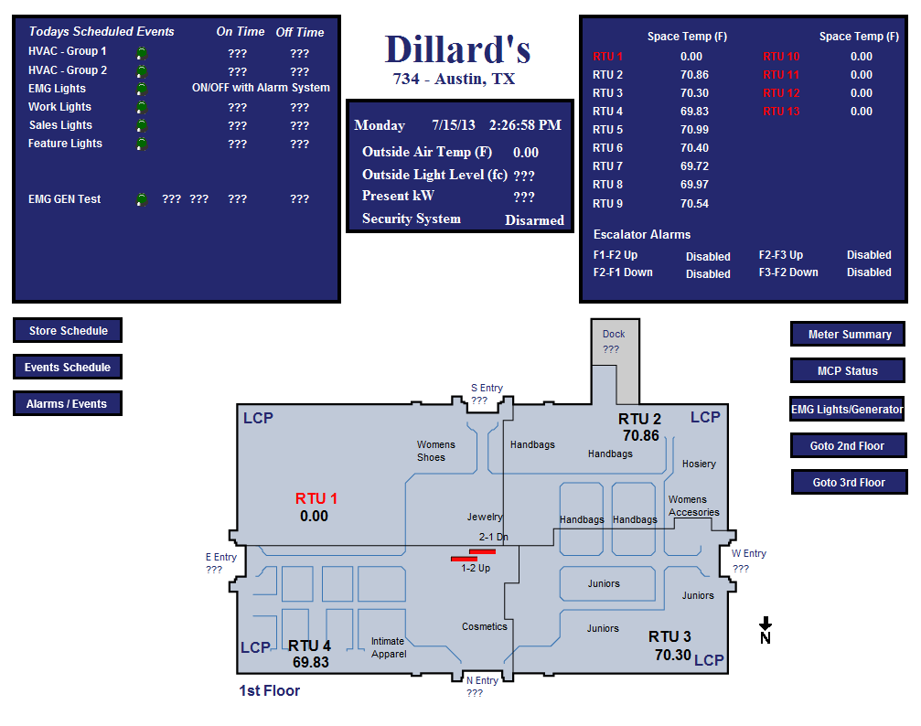

Slide 14
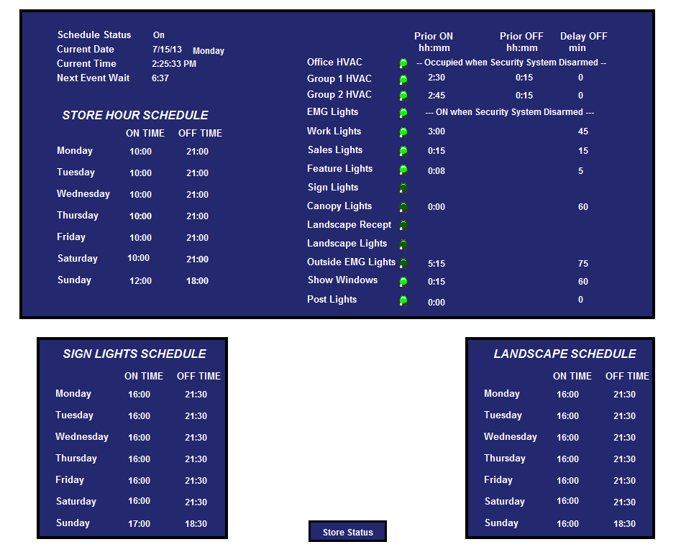

Slide 15
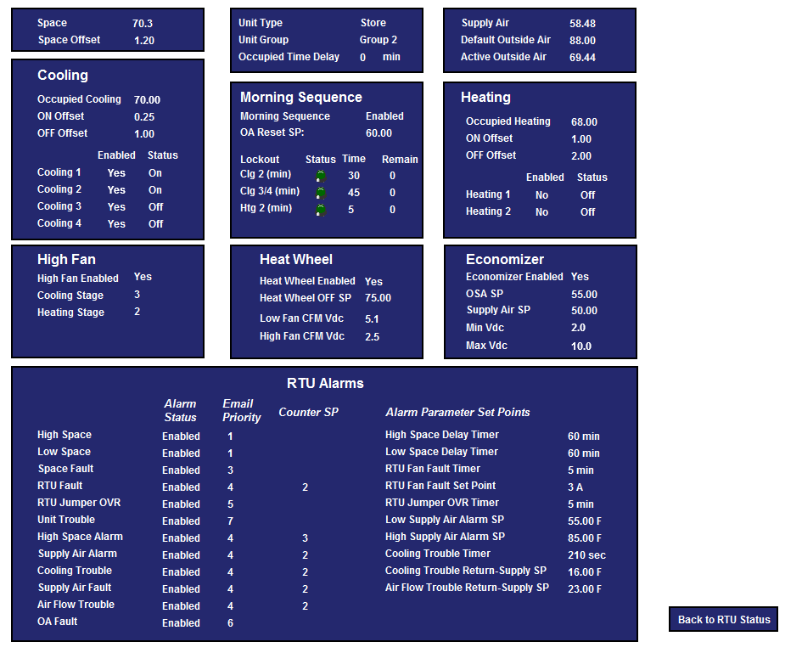
EMS – RTU Detail Screen

Slide 16
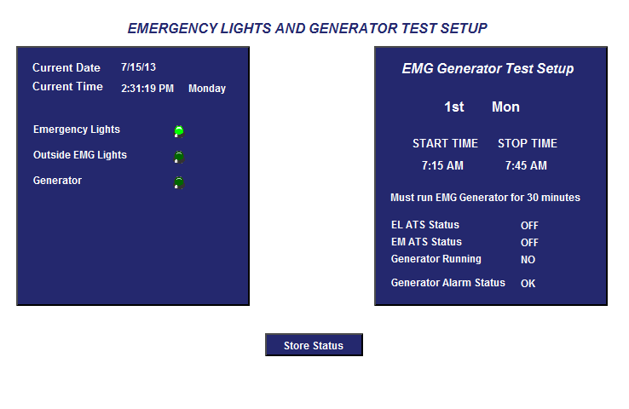

Slide 17
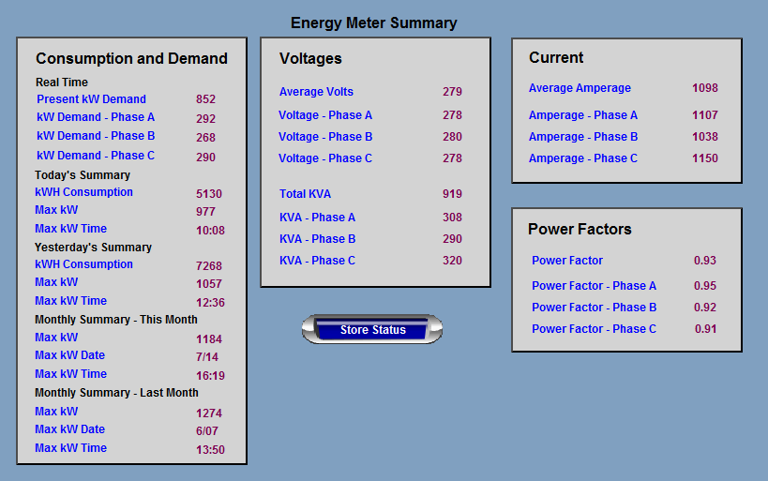

Slide 18
The Power of Off!

Slide 19
Morning Start Up Sequence - Before

Slide 21
Morning Start Up Sequence After

Slide 23
Comparing Before and After

Slide 24
Questions?

